Slide 1
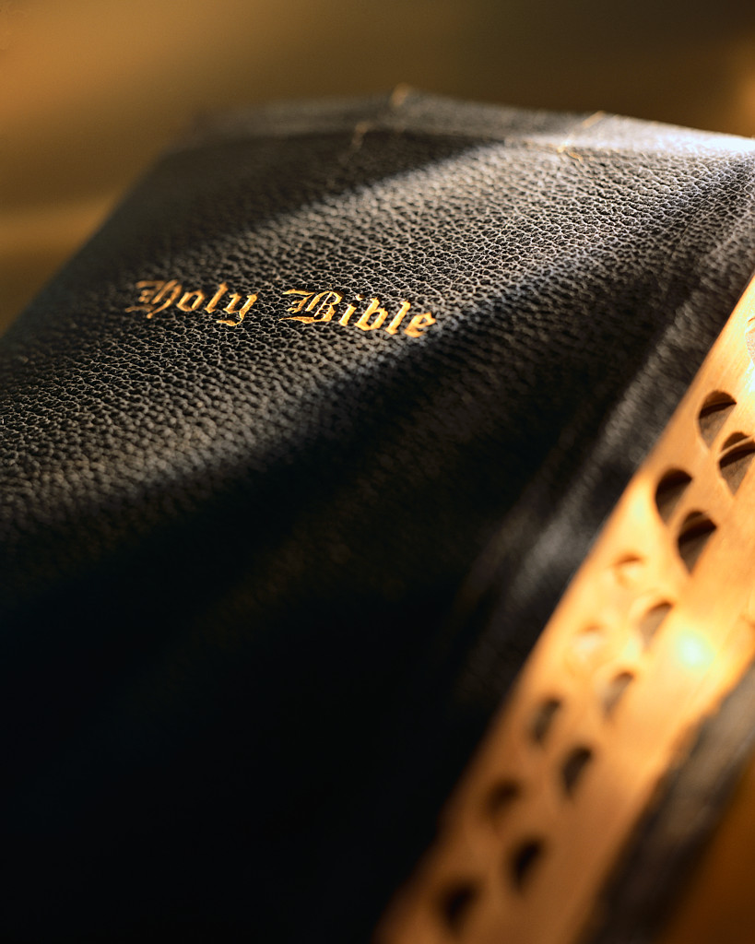
Review:
What IS Expository Preaching?
Dr. Jeffrey Arthurs, Gordon-Conwell Theological Seminary,
as taught at Singapore Bible College DMin module, March 2016
and offered for free download by Dr. Rick Griffith at BibleStudyDownloads.org

Slide 2
Expository Preaching is NOT . . .
A lecture.

Slide 3
Not an Expository Sermon:
“Where is the Lamb?”
(Genesis 22:1-19)
God commanded Abraham (1-2).
Abraham journeyed (3-5).
Abraham prepared for sacrifice (6-10).
God rescued Abraham (11-14).
Abraham passed the test (15-19).

Slide 4
Two Stances
Lecturing
Preaching
Attention
Attention
The Lecturer Talks…
The Preacher Talks…
in past tense, to inform,
about the Bible (“God did such and such for the Israelites”),
in 3rd person,
in an uninvolved, reporting style.
in present tense, to produce change,
about themselves from the Bible, (“God says to us…”)
in 1st and 2nd person,
in an emotionally involved style

Slide 5
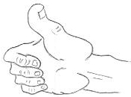
Genesis 22:1-19
Better:
God’s commands sometimes sound preposterous.
  God called Abraham to sacrifice his only son.
  God often calls us to obey beyond our logic and emotions.
Obedience in those circumstances hinges on our faith.
  Abraham’s faith was built on a lifetime of covenant relationship with God.
  We too have a covenant relationship with God.
  So we too can obey as Abraham did, knowing and trusting our great God.

Slide 6
Expository Preaching is NOT . . .
A lecture.
A spiritual talk loosely based on the Bible.

Slide 7
Not an Expository Sermon:
“What If the Foundations are Destroyed?”
(Psalm 11:3)
The foundation of morality.
The foundation of the family.
The foundation of prayer.

Slide 8
Psalm 11
Better:
The wicked taunt us (vv. 1b-3).
The Lord sees this and will punish them (vv. 4-6)
Therefore, the righteous take refuge in the Lord (vv. 1a, 7).

Slide 9
Expository Preaching is NOT . . .
A lecture.
A spiritual talk loosely based on the Bible.
A style.

Slide 10
Expository Preaching:
False Stereotypes
Dry/uninvolved . . . . . . . . . . . . . . . . . . . . Passionate
One long passage . . . . . . . . . . . . . . Short passage(s)
Verse-by-verse commentary . . . . . . . . . . . . . . Other
A Delivery Style
Length of Passage
A Form

Slide 11
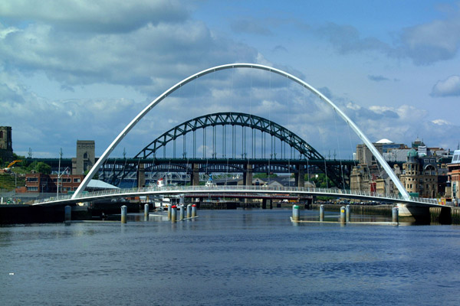
Expository Preaching is
Bridge Building

Slide 12

I’ve discovered that it’s not hard to be biblical if you don’t care about being contemporary. And it’s certainly not hard to be contemporary if you don’t care about being biblical. Being biblical and contemporary– that’s the art of Christian communication.
John Stott
In Palmer, Hestenes, and Hendricks. Mastering Teaching (Portland: Multnomah, 1991) 80.

Slide 13
Robinson’s definition of Biblical Preaching
The communication of a biblical concept, derived from . . . historical, grammatical, and literary study of a passage in its context, which the Holy Spirit first applies to the personality and experience of the preacher, then through the preacher applies to the hearers.

Slide 14
So, being an Expository Preacher implies three commitments:
A commitment to the text.

Slide 15
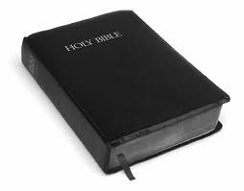
Expository preaching is more of an attitude than a method or style. Do you subject the Scripture to your thoughts or your thoughts to the Scripture?

Slide 16
So, being an Expository Preacher implies three commitments:
A commitment to the text.
A commitment to the people.

Slide 17
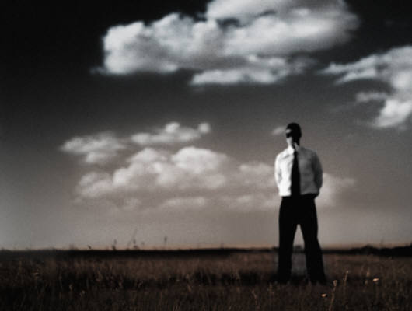
Preaching divorced from pastoral concern is blind. It neither knows what it is talking about nor to whom it is talking.
Ian Pitt-Watson, Preaching: A Kind of Folly (Philadelphia: Westminster Press, 1976), 58.

Slide 18
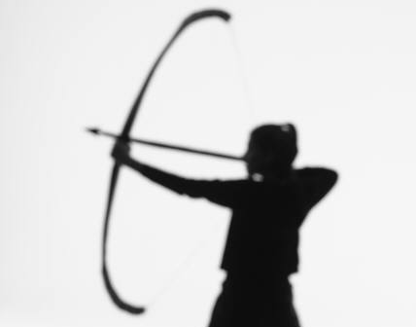
Every sermon is stretched like a bowstring between the text of the Bible on the one hand and the problems of contemporary human life on the other. If the string is insecurely tethered to either end, the bow is useless. It is a wise precaution for every preacher to pay special attention to the end of the string which for him is the less securely tethered.
Ian Pitt-Watson, Preaching: A Kind of Folly (Philadelphia: Westminster Press, 1976), 57.

Slide 19
So, being an Expository Preacher implies three commitments:
A commitment to the text.
A commitment to the people.
A commitment to yourself (to be a conduit).

Slide 20
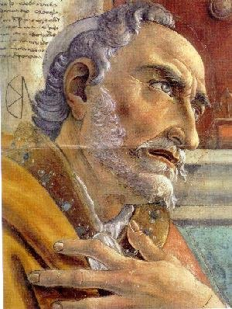
The life of the speaker has greater weight in determining whether he is obediently heard than any grandness of eloquence.
Augustine, On Christian Doctrine, trans. Robertson, 164.

Slide 21
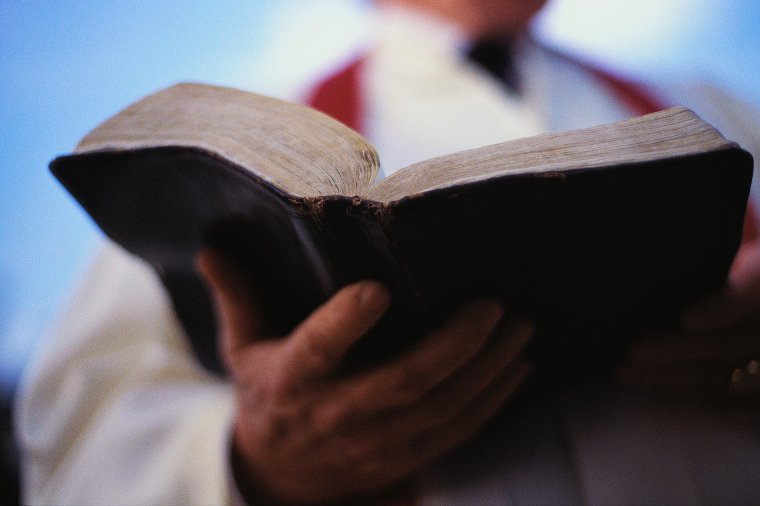
Why Expository Preaching?

Slide 22
Six Reasons
I want you to be an
Expository Preacher
The power is in the Word.

Slide 23
We Believe in the Power of the Word
Fire (Jer. 23:29)
Hammer (Jer. 23:9)
Rain (Isa. 55:10-11)
Milk (1 Peter 2:2)
Sword (Heb. 4:12; Eph. 6:17)
Mirror (James 1:23-25)
Lamp (Ps. 119:105; Prov. 6:23; 2 Peter 1:19)

Slide 24

“Everywhere we turned the data revealed the same truth: spending time in the Bible is hands down the highest impact personal spiritual practice.” (p. 115)
Reflecting on Scripture is the “vanilla factor” for spiritual growth.” (p. 116)

Slide 25

St. Paul's Collegiate Church (Storr’s CT)
Participation in the
Four Key Individual Spiritual Practices
Notes:
This chart shows your congregation’s level of Individual Spiritual Practices. We show results for the four segments along the spiritual continuum and the total for your church.
Note any category that has upward or downward arrows since those will indicate if your response is significantly different from the Total Sample.
If there is no arrow, that means your response falls within 20% on either side of the average for the Total Sample, so it’s basically “on par” with the Total Sample.
As noted in the prior slide, these Individual Spiritual Practices are very powerful catalysts for spiritual growth across all segments, especially Bible Reading.

Slide 26
Six Reasons
I want you to be an
Expository Preacher
The power is in the Word.
Through preaching, God calls forth and grows the Church.

Slide 27
Through Preaching God Saves
(1 Peter 1:23, 25) You have been born again though the living and abiding Word of God. . . . The word that was preached to us.
(2 Timothy 3:15) From infancy you have known the holy Scriptures which are able to make you wise for salvation through Jesus Christ.
Faith comes by hearing the Word of God and that demands that someone preach (Romans 10:14-15).
(John 15:3) You are already clean because of the word I have spoken to you.

Slide 28
For Example: the Book of Acts
“Peter stood up with the eleven, raised his voice and addressed the crowd,” and about 3,000 were added to infant church in Jerusalem (2:14ff.).
“Those who had been scattered preached the word wherever they went,” and the church in Samaria was formed (8:4ff).
“Those who had been scattered . . . traveled as far as Phoenicia, Cyprus, and Antioch telling the message,” and the church in Syria was formed (11:19ff).
“Almost the whole city gathered to hear the word of the Lord . . . and all who were appointed for eternal life believed,” and the church in Asia Minor was formed (13:44, 48).

Slide 29
For Example: the Book of Acts
“As was his custom, Paul went into the synagogue and reasoned with them from the Scriptures, explaining and proving that Christ had to suffer and rise from the dead,” and the church in Macedonia was formed (17:2ff).
“Then Paul stood up in the meeting of the Areopagus” to proclaim the unknown God, and the church in Greece was formed (17:22ff).

Slide 30
Through Preaching God Grows the Church
(John 17:17) Sanctify them by the truth. Your word is truth.
(Col. 1:28-29) We proclaim him, admonishing and teaching everyone . . . so that we may present everyone perfect in Christ. To this end I labor, struggling with all his energy.
(1 Tim. 4:13) [Therefore] devote yourself to the public reading of Scripture, to preaching and to teaching.

Slide 31
For Example: The Early Church
Justin Martyr: “On the day called Sunday, all who live in cities or in the country gather together to one place, and the memoirs of the apostles or the writings of the prophets are read, as long as time permits; then, when the reader has ceased, the president verbally instructs, and exhorts to the imitation of these good things.”
Tertullian: “We assemble to read our sacred writings . . . . With the sacred words we nourish our faith, we animate our hope, and make our confidence more steadfast . . . and we confirm good habits. In the same place also exhortations are made, rebukes and sacred censures are administered.”

Slide 32
Six Reasons
I want you to be an
Expository Preacher
The power is in the Word.
Through preaching, God calls forth and grows the Church.
We are commissioned as heralds and stewards.

Slide 33
Dr. Timothy Keller on
Expository Preaching:
A full confidence and rich grasp of the authority and inspiration of the Bible is absolutely crucial for a sustained, life-changing ministry of Bible teaching and preaching. . . . It is not enough for you to just have a general respect for the Bible. . . . Unless your understanding of the Bible—and confidence in its inspiration and authority—are deep and comprehensive, you will not be able to do the hard work to understand and present it convincingly.
Preaching, 32-34

Slide 34
κῆρυξ
A messenger vested with authority to convey an official message from kings, commanders, or other officials; one who gave a public summons or demand.
Mounce, The Essential Nature of NT Preaching: “The proclamation must be delivered exactly as it was received. As the mouthpiece of his master, he dare not add his own interpretation.”
(1 Timothy 2:7) I was appointed a preacher and apostle.

Slide 35
οἰκόνoμος
A “house manager” –a servant entrusted by the owner of the house with the management of his affairs, including feeding the other servants and even the owner’s underage children.
(1 Cor. 4:1-2) “Men ought to regard us as servants of Christ and as those entrusted with the secret things of God. Now it is required that those who have been given a trust must prove faithful.”

Slide 36
Six Reasons
I want you to be an
Expository Preacher
The power is in the Word.
Through preaching, God calls forth and grows the Church.
We are commissioned.
We will be judged.

Slide 37
Because we are heralds and stewards, we will be judged:
(2 Tim 4:1-2) In the presence of God and of Christ Jesus, who will judge the living and the dead, and in view of his appearing and his kingdom, I give you this charge: Preach the Word; be prepared in season and out of season; correct, rebuke, and encourage with great patience and careful instruction.
(Heb 13:17) Obey your leaders and submit to them, for they are keeping watch over your souls, as those who will have to give an account.

Slide 38
Six Reasons
I want you to be an
Expository Preacher
The power is in the Word.
Through preaching, God calls forth and grows the Church.
We are commissioned.
We will be judged.
We are models.

Slide 39
Dr. Timothy Keller again:
A steady diet of expository sermons teaches your audience how to read their own Bibles, how to think through a passage and figure it out. Exposition helps them understand why different phrases mean what they do within the story line of the Bible.
Preaching, 38.

Slide 40
Six Reasons
I want you to be an
Expository Preacher
The power is in the Word.
Through preaching, God calls forth and grows the Church.
We are commissioned.
We will be judged.
We are models.
As an expositor, the Bible is what sets the agenda for your organization and yourself.

Slide 42
Review: Six Reasons
The power is in the Word.
Through preaching, God calls forth and grows the Church.
We are commissioned.
We will be judged.
We are models.
As an expositor, the Bible is what sets the agenda for your organization and yourself.

Slide 43
Review
Big Idea Preaching

Slide 44
Robinson’s Stages
Choose the passage.
Study the passage. We are trying to discern the author’s intended meaning.
State the exegetical idea.

Slide 45
An Idea is Made up of Two Parts:
Subject:
Always phrased as a question.
Complement:
Answers the question . . .

Slide 46
An Idea is Made up of Two Parts:
Subject:
What does this country need?
Complement:
Answer the question . . .

Slide 47
An Idea is Made up of Two Parts:
Subject:
What is the test of a man’s character?
Complement:
Answer the question . . .

Slide 48
Exegetical Idea
Subject:
What is the author talking about? (remember, the subject is always phrased as a question)
Complement:
What is the author saying about what he/she is talking about? (answer the question)

Slide 49
John Stott:
In our sermon preparation we must not try to bypass the discipline of waiting patiently for the dominant thought to disclose itself. We have to be ready to pray and think ourselves deep into the text until we give up all pretense of being its master or manipulator and become instead its humble and obedient servant. Then the Word of God will dominate our minds, set fire to our hearts, . . . and later leave a lasting impression on the congregation.

Slide 50
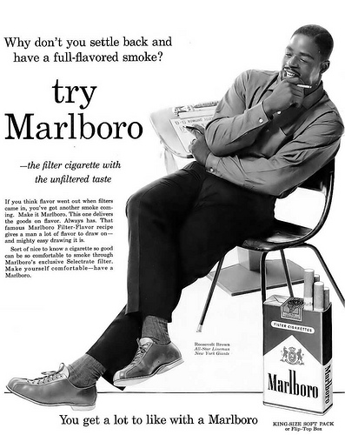
What idea is the advertiser communicating?
Subject?
Complement?

Slide 51
How Determine the Exegetical Idea?
Get in the ballpark!

Slide 52
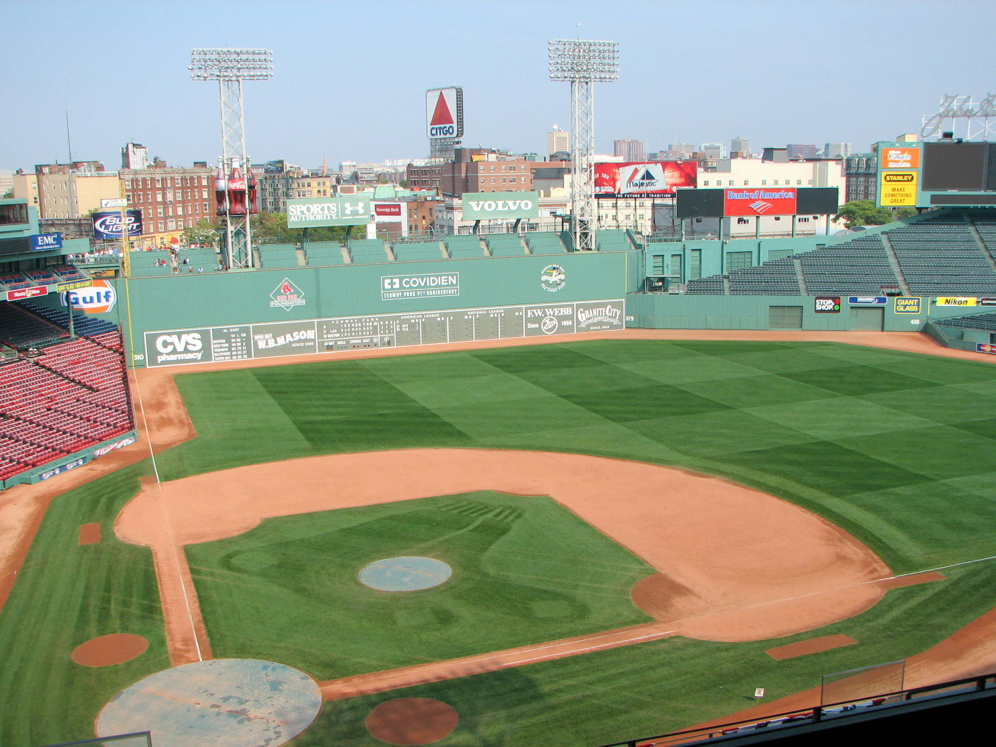
Misreading
Broad Subject
Narrow Subject Question
Answer with Complement

Slide 53
How Determine the Exegetical Idea?
Get in the ballpark!
State the broad subject.
Narrow that subject into a precise phrase, worded as a question (who, what, why, when, where, how).
Answer the question thoroughly with the text’s data.

Slide 54
How Determine the Exegetical Idea?
State the broad subject.
  Faith.
  Standing in God’s holy hill.
  Abraham sacrificing Isaac.
Narrow that subject into a precise phrase, worded as a question.
  Where did Paul say saving faith comes from?
  According to the psalmist what qualities enable a person to stand in God’s holy hill?
  How did God provide for Abraham when he tested him with the command to sacrifice his son, Isaac?
Answer the question thoroughly with the text’s data.

Slide 55
You try it:
Groups of 3-4.
Psalm 117.
State subject, complement, and idea.
5 minutes. Go!

Slide 56
Exegetical Idea: Psalm 117
Subject:
Complement:
Idea:

Slide 57
Common Mistakes with the Exegetical Idea:
Too broad. Results in a thematic sermon rather than rigorously expository.
  The Ex Idea should be as long as necessary for accuracy and thoroughness.
  “Field trip” to see some of Arthurs’ Ex Ideas.
Neglects key elements of the text.
Moves too quickly to application.

Slide 58
You try it:
Groups of 3-4.
Luke 1:1-4.
State subject, complement, and idea.
5 minutes. Go!

Slide 59
Exegetical Idea: Luke 1:1-4
Subject:
Complement:
Idea:

Slide 60
Robinson’s Stages
Choose the passage.
Study the passage.
State the Exegetical Idea.
State a Homiletical Idea.

Slide 61
After discovering the Exegetical Idea . . . rephrase it as the sermon’s Homiletical Idea. This is also called the “Big Idea.”

Slide 62
Compare:
Exegetical Idea
Purpose: To summarize the passage.
Length: As long as needed for accuracy and thoroughness.
Subjects: Third person.
Tense: Past.
Homiletical Idea
Purpose: To communicate the message of the passage for your listeners.
Length: 15 words or fewer.
Subjects: First or second person.
Tense: Present or “timeless.”

Slide 63
The Homiletical Idea should be:
Clear.
Concise.
Compelling.
Creative.

Slide 64
Homiletical Idea
Robinson: “A statement of a biblical concept in such a way that it accurately reflects the Bible and meaningfully relates to the congregation.”
Jowett: This idea should be as “clear as a cloudless moon.”
Spurgeon: “Give them a loaf of bread, not a wheat field.”
Spurgeon: “One nail driven home is better than twenty tacks loosely fixed to be pulled out in an hour.”

Slide 65
Big Idea Preaching
“Every time I stand to communicate I want to take one simple truth and lodge it in the heart of the listener.”
Andy Stanley
The Birth of a One-Point Preacher

Slide 66
Big Idea Preaching
“How many things is a sermon about? One!… The major idea, or theme, glues the message together and makes its features stick in the listener’s mind. All the features of the entire sermon should support the concept that unifies the whole.”
Bryan Chapell
Christ-Centered Preaching

Slide 67
Big Idea Preaching
“The central idea of a true expository message reflects the central idea intended by the Bible author himself.”
John MacArthur
Rediscovering Expository Preaching

Slide 68
Big Idea Preaching
“A sermon must be like an arrow, streamlined and clearly driving at a single point, a single message, the theme of the passage.”
Timothy Keller
A Model for Preaching

Slide 69
Sample Homiletical Ideas
“Avoid sexual immorality.” (1 Thess. 4:1-8)
“Give your life to wisdom, and wisdom will give life to you.” (Proverbs 4:20-27)
“Your neighbor is anyone in need you see, whose need you can meet, whose need you do meet.” (Luke 10:25-37)

Slide 70
Communicating the Homiletical Idea
How many times should you repeat it?
How can you emphasize it with techniques other than repetition?
  Restatement.
  Placement.
  Image.
  Multiple channels.
  Delivery.

Slide 71
Failure to emphasize the Homiletical Idea will . . .
Prompt the audience to create their own (usually based on a smaller point that grabbed them).
  This is not the end of the world.
Leave the audience in a fog.
  This is the end of the world.

Slide 72
Note: To state the homiletical idea, you often have to travel through theology. Discover the “timeless truths” about God and humanity.

Slide 73
Textual
Message
What did God say
and how did He
say it?
Theological
Message
What does God say
and do?
Contextualized
Message
How will I say what
God is saying and
do what God is
doing?
Correlation Bridge
Discontinuities
Continuities
Contextualization
Bridge
Faithful to the Scriptures
Obvious from the passage
Related to fallen condition
Connected to Christ
Engaging heart & mind
Adapted from Campus Crusade

Slide 74
Big Idea: Compare
Pelton (Preaching with Greater Accuracy)
Robinson (Biblical Preaching)
Exegetical Idea
Homiletical Idea
Texbi (textual big idea).
Conbi (contextual big idea).
Canbi (canonical big idea).
Hombi (homiletical big idea).

Slide 75
Review: Robinson’s Stages
Choose the passage.
Study the passage.
State the Exegetical Idea.
State a Homiletical Idea.

Slide 76
Black

Slide 77


Preaching (Homiletics) link at BibleStudyDownloads.org
Get this presentation for free!
Notes:
Preaching (pr)
Homiletics

